Slide 1
Exploring Dynamic Selection of Branch Expansion Orders for Code Generation
Hui Jiang¹, Chulun Zhou¹, Fandong Meng², Biao Zhang³, Jie Zhou², Degen Huang⁴, Qingqiang Wu¹, Jinsong Su¹
¹Xiamen University; ²WeChat AI, Tencent Inc.; ³University of Edinburgh; ⁴Dalian University of Technology.
ACL 2021

Slide 2
Introduction
Seq2tree models expand nodes in a depth-first left-to-right order.
What about different orders, like a right-to-left one?
Model | Multi-branch nodes that can only be handled by this model
TRANX | 8.47%
TRANX-R2L | 7.66%
Dynamic selection of branch expansion orders in this paper:
Use a context-based branch selector.
Reinforcement learning due to non-differentiable multi-step generation.
Reward based on training loss between different expansion order.

Slide 3
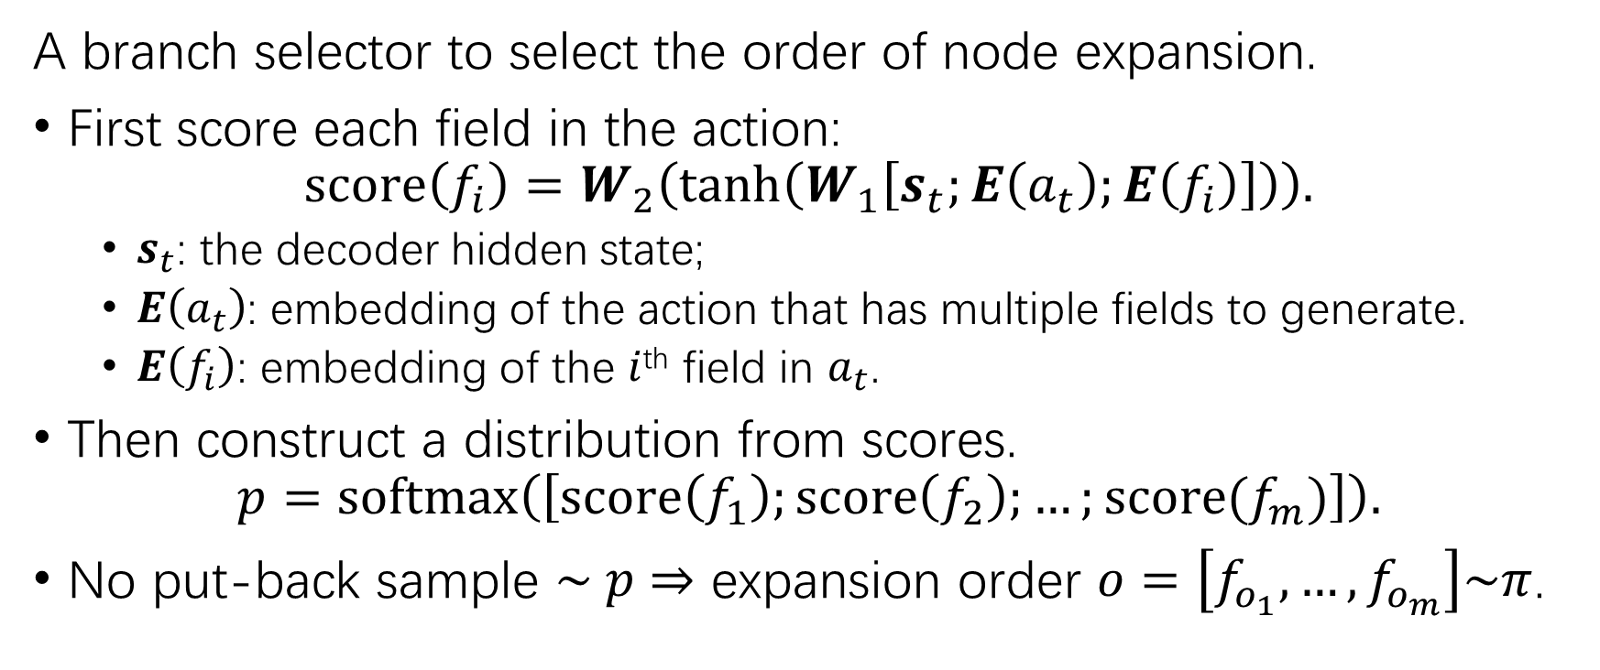
Branch selector
A branch selector to select the order of node expansion.
First score each field in the action:
$$score\left(f_{i}\right)=W_{2}\left(\tanh\left(W_{1}\left[s_{t};E\left(a_{t}\right);E\left(f_{i}\right)\right]\right)\right).$$
$s_{t}$: the decoder hidden state;
$E\left(a_{t}\right)$: embedding of the action that has multiple fields to generate.
$E\left(f_{i}\right)$: embedding of the $i$^{th} field in $a_{t}$.
Then construct a distribution from scores.
$$p=softmax\left(\left[score\left(f_{1}\right);score\left(f_{2}\right);…;score(f_{m})\right]\right).$$
No put-back sample $\sim p$ $⇒$ expansion order $o=\left[f_{o_{1}}, …,f_{o_{m}}\right]\sim π$.

Slide 4
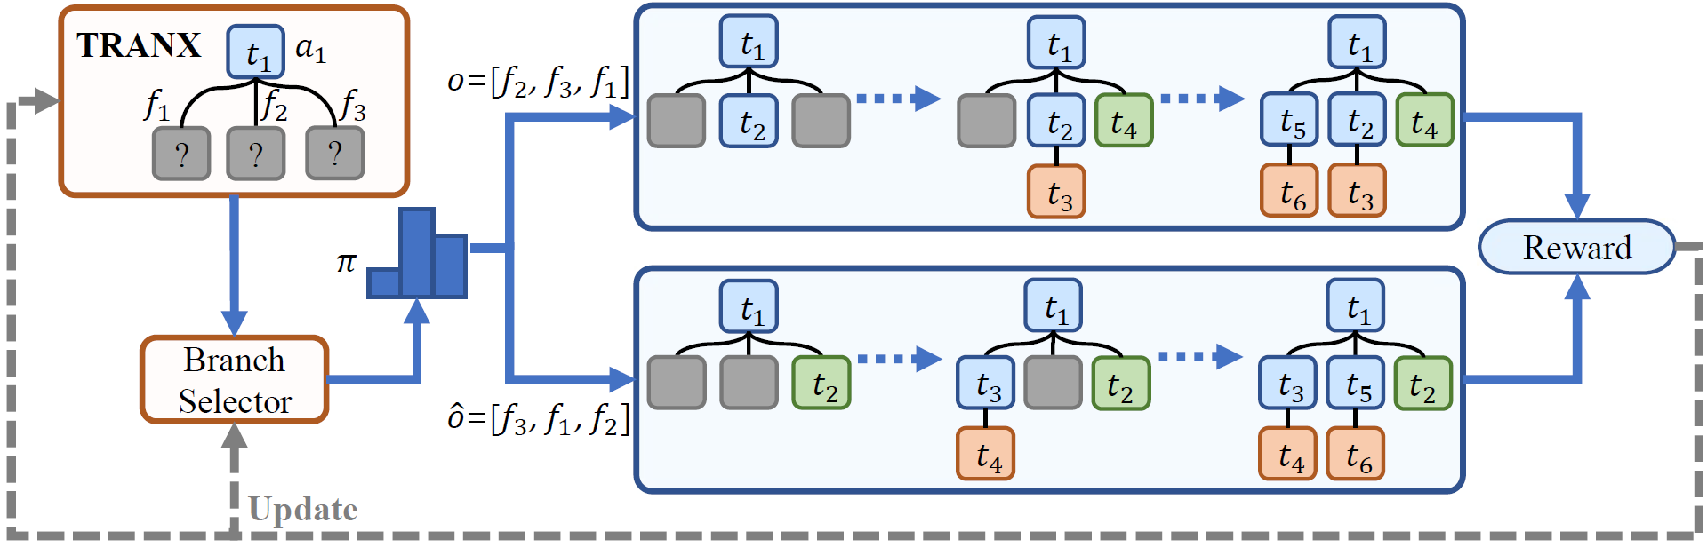
Reinforced training

Slide 5
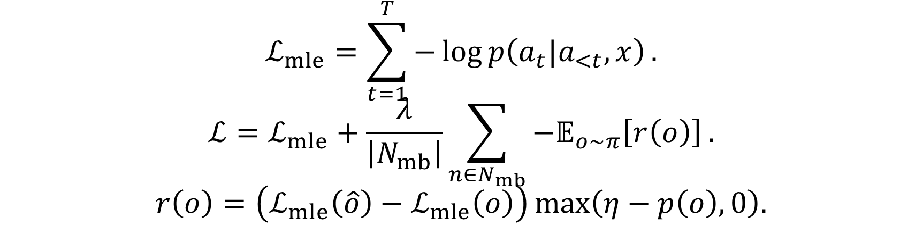
Reinforced training
$$ℒ_{mle}=\sum_{t=1}^{T}{−\log{p\left(a_{t}|a_{<t},x\right)}}.$$
$$ℒ=ℒ_{mle}+\frac{λ}{\left|N_{mb}\right|}\sum_{n∈N_{mb}}{−𝔼_{o\sim π}\left[r\left(o\right)\right]}.$$
$$r\left(o\right)=\left(ℒ_{mle}\left(\hat{o}\right)−ℒ_{mle}\left(o\right)\right)\max\left(η−p\left(o\right),0\right).$$
Note that gradient of $r\left(o\right)$ is not used to update parameters.
Pretraining
$$ℒ_{pretrain}=𝔼_{p\sim 𝒰\left(N\left(x\right)\right)}\left[ℒ_{mle}\right].$$

Slide 6
Experimental results
Model | DJANGO | ATIS | GEO | CONALA
 | Accuracy | Accuracy | Accuracy | BLEU | Accuracy
COARSE2FINE | - | 87.7 | 88.2 | -
TRANX | 77.3±0.4 | 87.6±0.1 | 88.8±1.0 | 23.45±0.4 | 2.5±0.7
TREEGEN | - | 88.1±0.6 | - | -
TRANX (reimplemented) | 77.2±0.6 | 87.6±0.4 | 88.8±1.0 | 24.38±0.5 | 2.2±0.5
TRANX (w/ pre-train) | 77.5±0.4 | 87.8±0.7 | 88.4±1.1 | 24.57±0.5 | 1.4±0.3
TRANX-R2L | 75.9±0.8 | 87.5±0.9 | 86.4±1.0 | 24.88±0.5 | 2.4±0.5
TRANX-RAND | 74.6±1.1 | 86.4±1.4 | 81.7±1.8 | 19.73±1.1 | 1,6±0.6
TRANX-RL (w/o pre-train) | 76.3±0.7 | 87.2±0.8 | 87.1±1.6 | 23.38±0.8 | 2.1±0.2
TRANX-RL | 77.9±0.5 | 89.1±0.5 | 89.5±1.2 | 25.47±0.7 | 2.6±0.4
TRANX (on child node) | 77.26±0.8 | 94.02±0.8 | 89.75±0.8 | - | 25.19±0.6
TRANX-R2L (on child node) | 76.88±1.0 | 93.80±0.3 | 89.28±1.1 | - | 24.74±0.7
TRANX-RL (on child node) | 78.98±0.9 | 94.87±0.5 | 90.64±0.9 | - | 26.90±0.6

Slide 7
Effect of the number of multi-branch nodes
ATIS | TRANX | TRANX-R2L | TRANX-RL
0 | 88.37 | 93.02 | 90.11
1 | 100 | 100 | 100
2 | 100 | 100 | 100
3 | 78.94 | 81.57 | 89.47
4 | 96.93 | 96.93 | 96.93
5 | 95.65 | 95.23 | 95.65
≥6 | 78.75 | 75.00 | 80.63
DJANGO | TRANX | TRANX-R2L | TRANX-RL
0 | 98.30 | 91.52 | 97.67
1 | 90.00 | 90.00 | 90.00
2 | 85.50 | 84.70 | 86.17
3 | 66.66 | 63.60 | 67.81
4 | 54.16 | 48.33 | 57.50
5 | 28.88 | 26.66 | 28.88
≥6 | 12.35 | 12.35 | 12.35

Slide 8
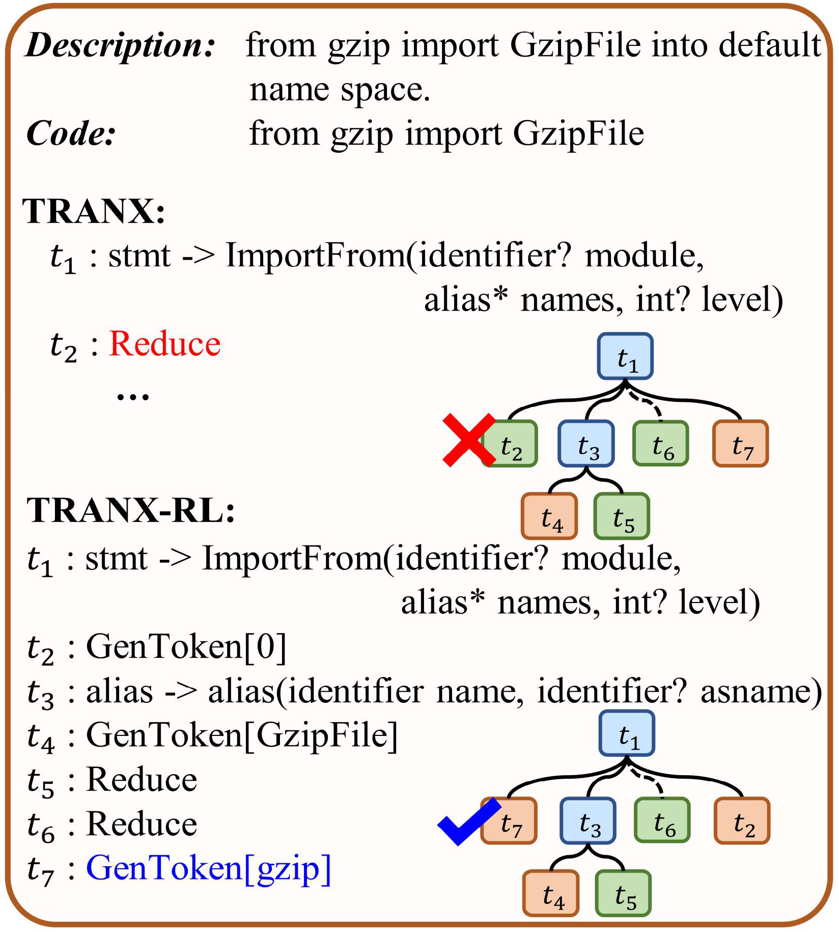
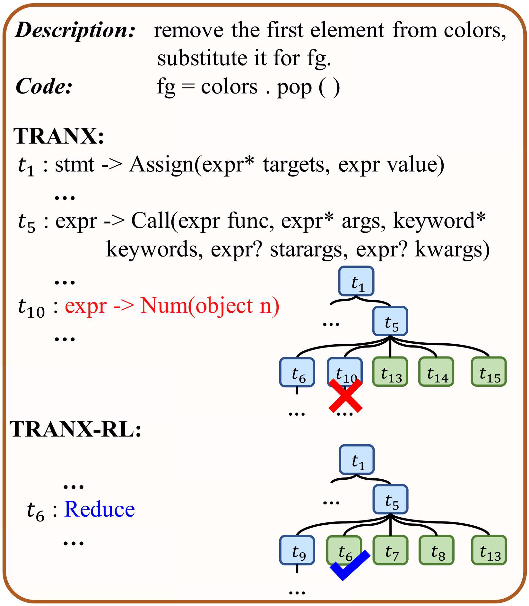
Case study

Slide 9
Conclusion
Some multi-branch nodes may benefit from non-L2R traversal.
Propose a seq2tree model with a context-based branch selector.
Adopt reinforcement learning to train the whole model.
With an elaborate reward that measures the model loss difference between different branch expansion orders.
Show the effectiveness and generality of the proposed model.
Future:
Extend the selector to deal with indefinite branches.

